Slide 1
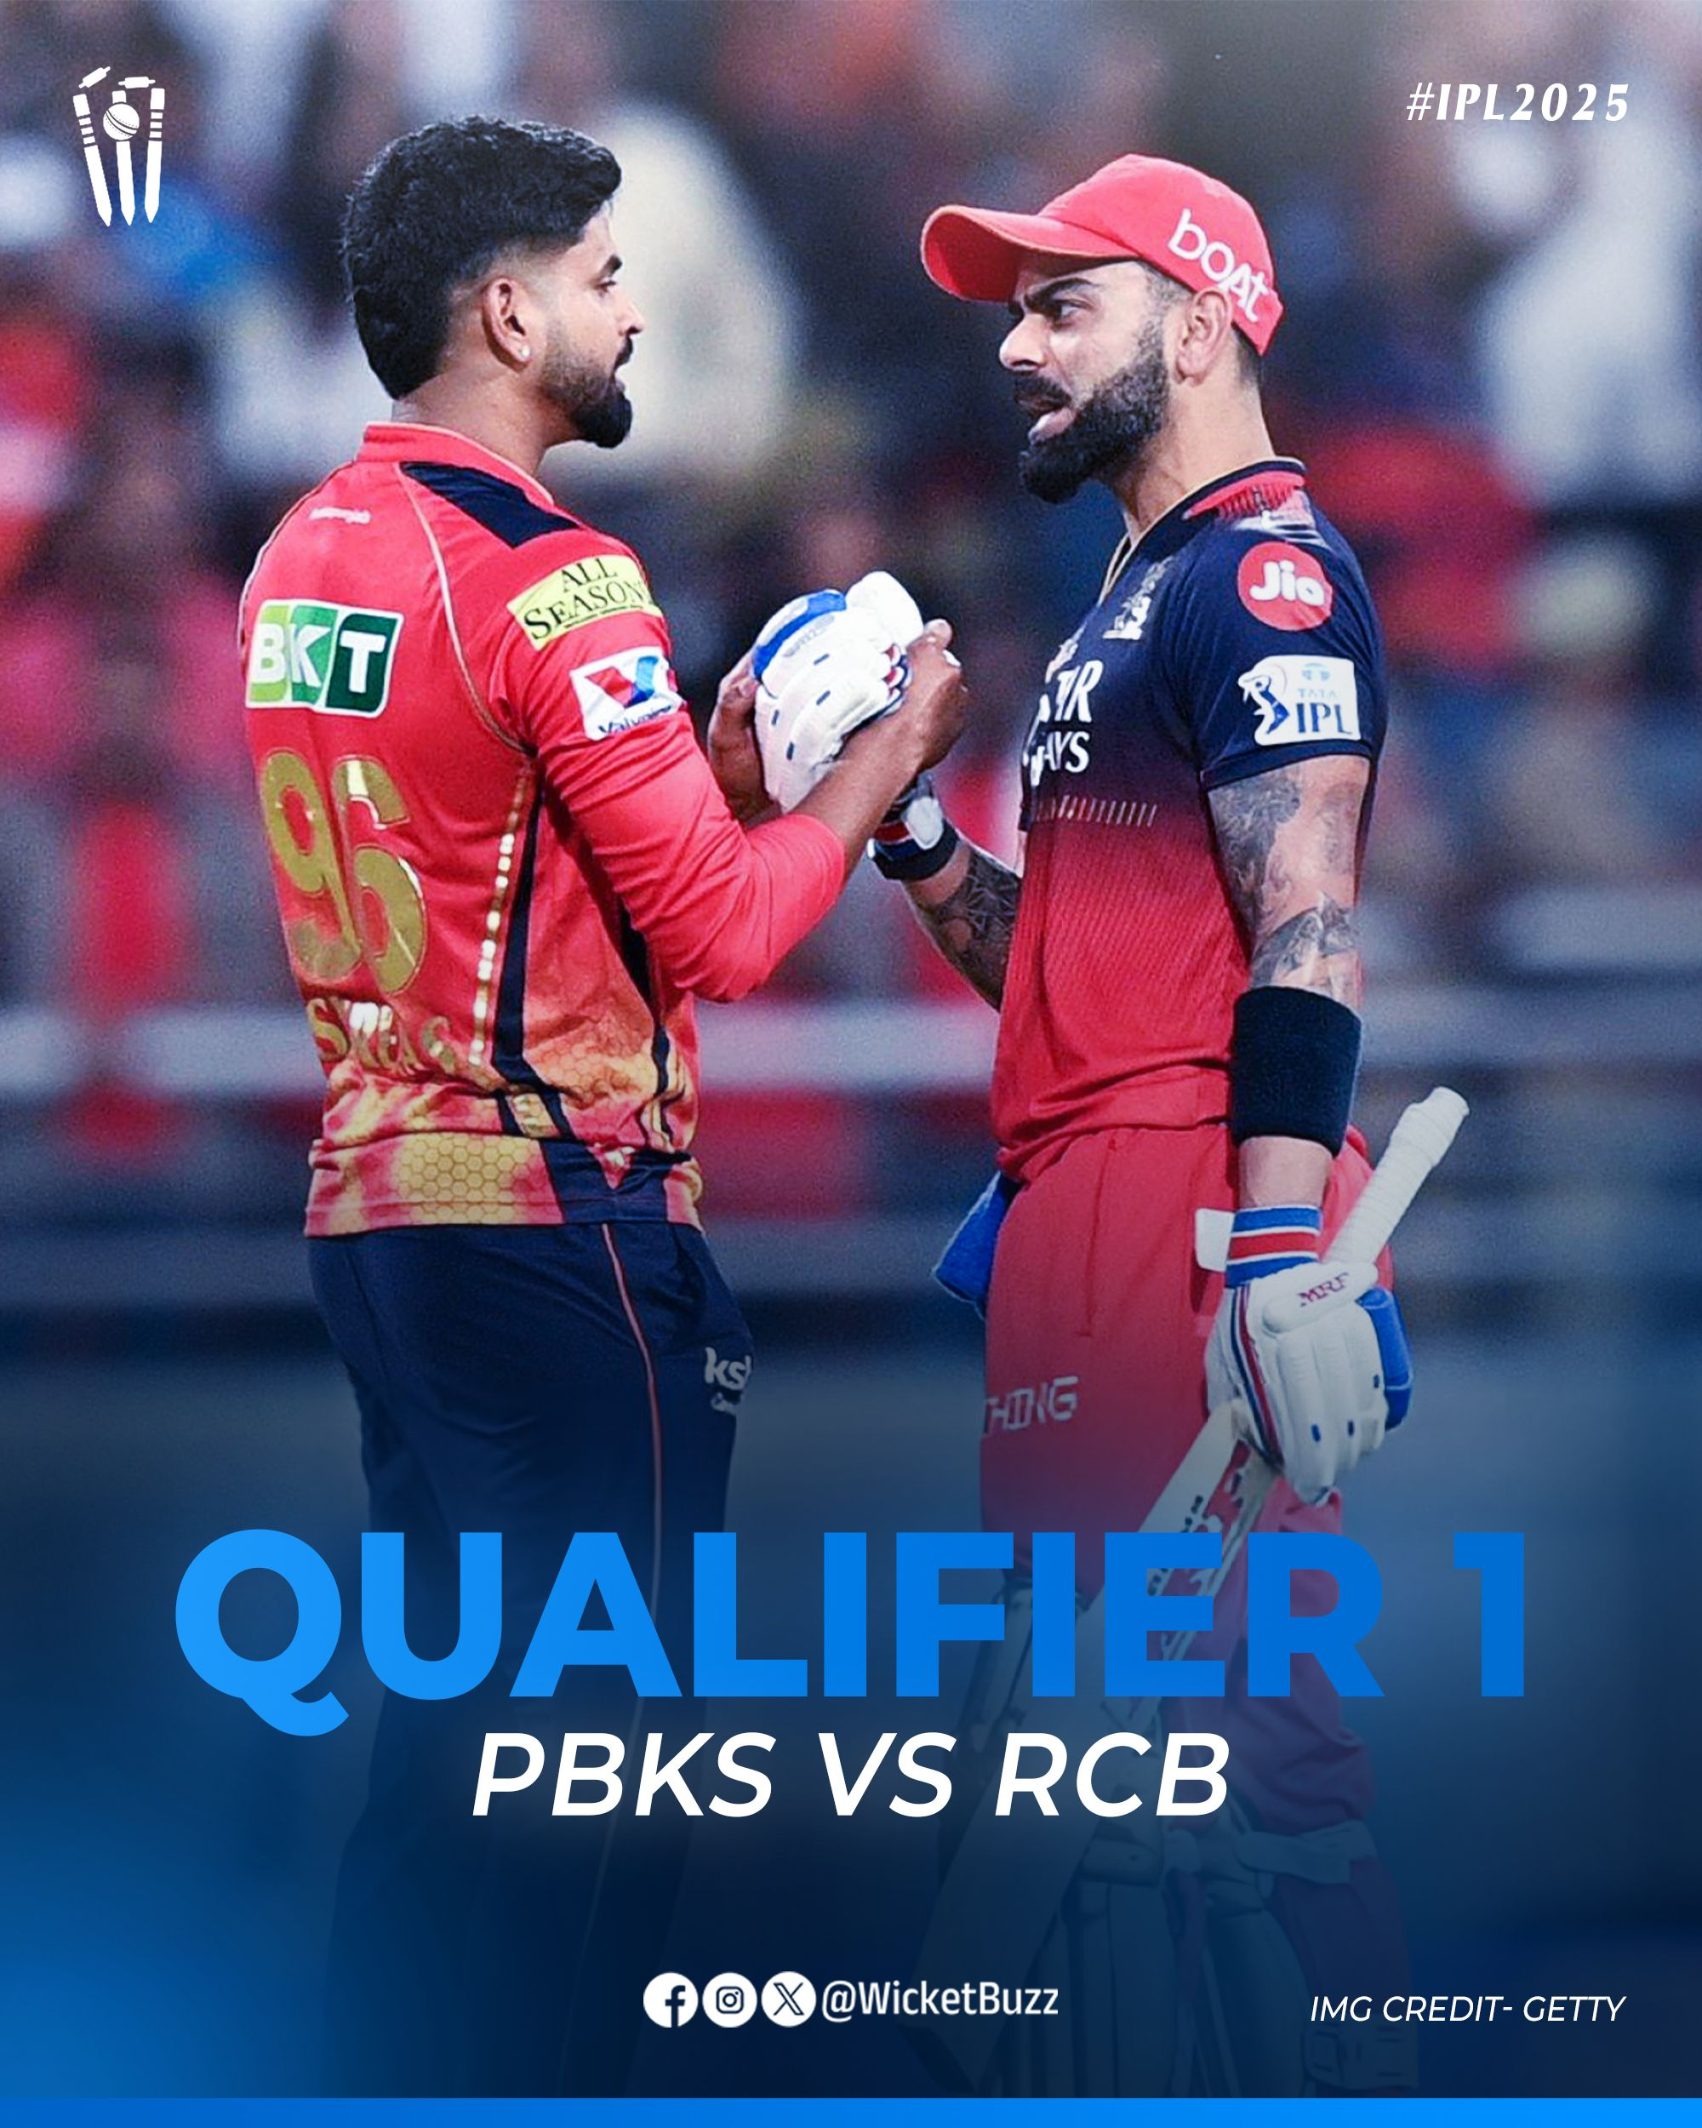
SQl Project on ipl 2025 qualifier 1 (Pbks Vs RCB)

Slide 2

Introduction to the project
Hello everyone! I’m Neetu, And This Is My SQL Project Based On IPL 2025 Match Analysis.
Using Ball-by-ball Data From The Official IPL Website, I Analyzed The Qualifier 1 Match Between RCB And PBKS. With MySQL, I Explored Key Match Insights Using Joins, Aggregations, And Window Functions — From Scoring Patterns To Player Performance.
This Project Helped Me Apply Data Analytics To The World Of Sports.

Slide 3
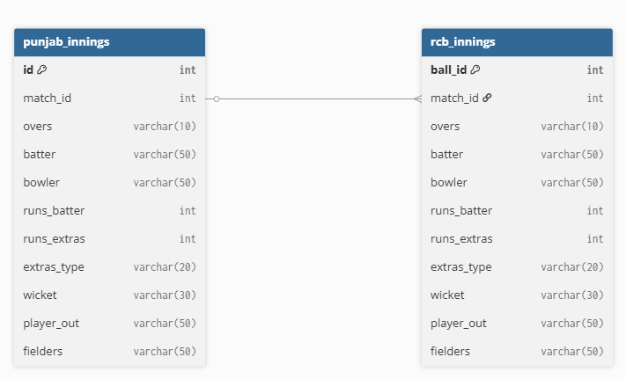
DATABASE SCHEMA OVERVIEW (Entity-relationship Diagram OF rcb vs Pbks qualifier 1 Database)

Slide 4
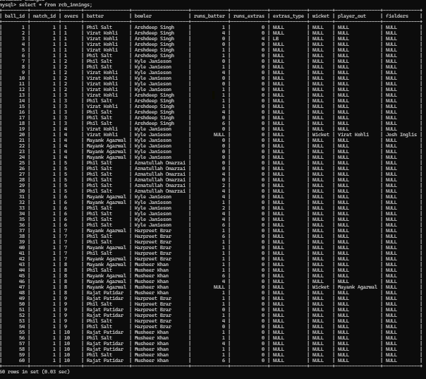
RCB Innings

Slide 5
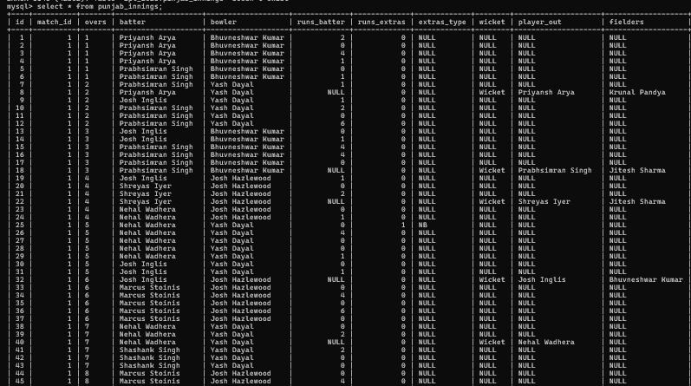
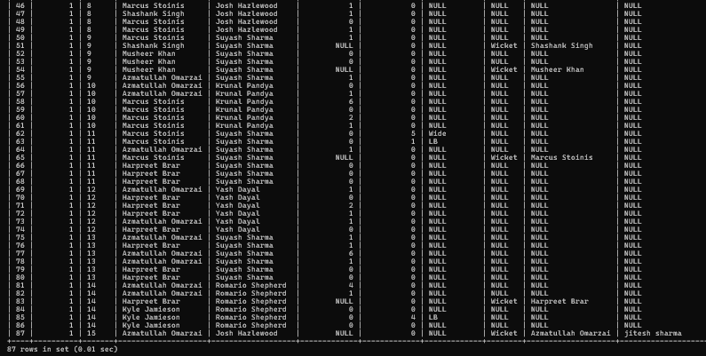
PBKS Innings

Slide 6
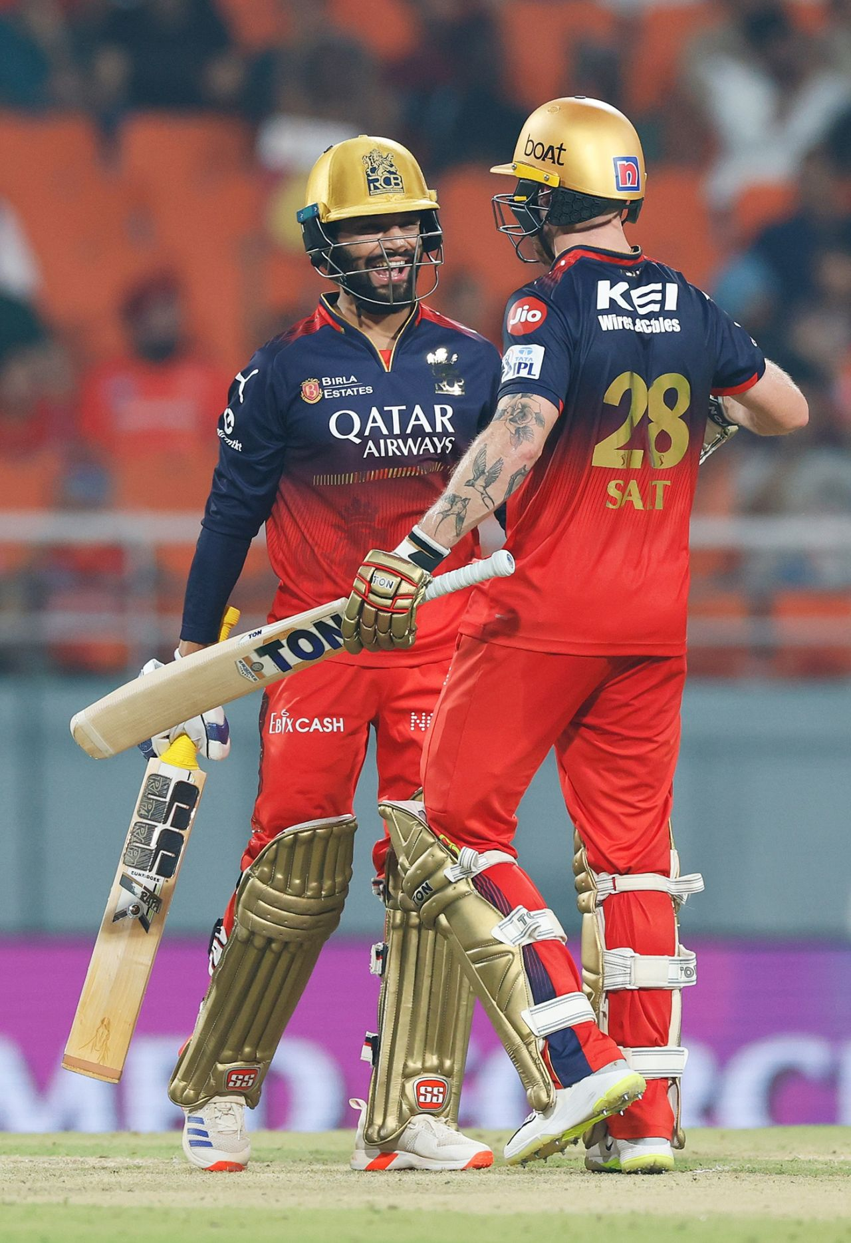

Retrieve the top 5 highest-scoring batters in the RCB innings based on total runs. Using ORDER BY and LIMIT

Slide 7
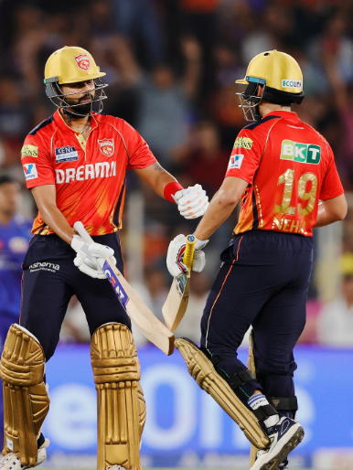
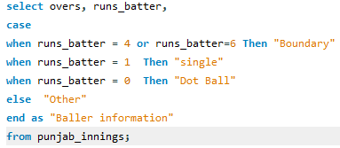
Classify each ball in the punjab innings as either a "boundary", "single", "dot ball", or "other" based on the runs_batter value. Using CASE:

Slide 8
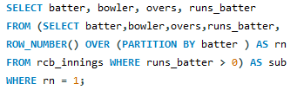
Identify the first scoring shot (non-zero runs_batter) for every batter in the RCB innings. -- Using ROW_NUMBER()

Slide 9

Rank bowlers in the Punjab innings based on the total runs they conceded, including extras. Using RANK():

Slide 10
Generate a cumulative scorecard showing the progressive total score after each ball in Punjab’s innings. -- Using SUM()

Slide 11

Find all bowlers who gave more than 10 runs in any over. -- Using HAVING Clause

Slide 12
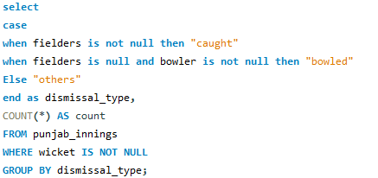
Count how many dismissals were caught, bowled, or others in the Punjab innings using wicket and fielders. -- Using CASE inside Aggregation

Slide 13
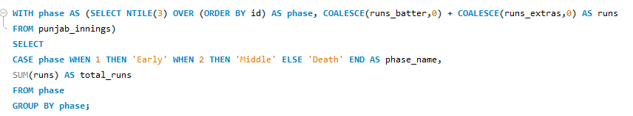
Divide Punjab’s innings into three phases (early, middle, and death overs) and calculate the total runs scored in each phase. -- Using NTILE() and CTE:

Slide 14
Total runs scored by each player in both teams

Slide 15
Thankyou

